Slide 1
KPLAY Learner Outcomes Pilot Study Report

Slide 2
Introduction
Based on KPLAY’s Theory of Change, this research project sought to explore how KPLAY changes teacher practice which transforms the learners’ learning experience and, ultimately, impacts learning outcomes.
The research indicates that changes in teacher practices are initiating a shift in the learning process and altering how learners interact with content. However, significant challenges persist in transforming classroom practices and the learning environment, posing obstacles and influencing learning outcomes.
This research points to key points where KPLAY could strengthen its offerings.
Notes:
Tip: Important to ensure that the audience understands that this is a pilot/exploratory study

Slide 3
KPLAY Theory of Change
If teachers in Kenya understand the value of and have access to localised, easy to implement learning through play with technology (LTPT) activities;
if they are empowered with the skills and mindsets to embrace and create LTPT;
and if they have support from and are held accountable by local education leaders, school leaders, coaches, peers, parents and communities to use LTPT;
then teachers will integrate LTPT effectively in the classroom and children in Kenyan primary schools will be able to learn 21st century skills through play.
Notes:
Tip: Important to ensure that the audience understands that this is a pilot/exploratory study

Slide 4
Research Design
Research Goal: Investigate the impact of teachers implementing instructional strategies based on learning through play in the classroom and its effect on learners Literacy and Numeracy.
Research methodology: The research employed a comparative approach; treatment schools from the 2021 cohort which were contrasted with a selected control group of schools.
Research Approach: Mixed methods of data collection and analysis
Quantitative: EGRA & EGMA at baseline and endline
Qualitative: Training observation, lesson observations & teacher interviews.

Slide 5
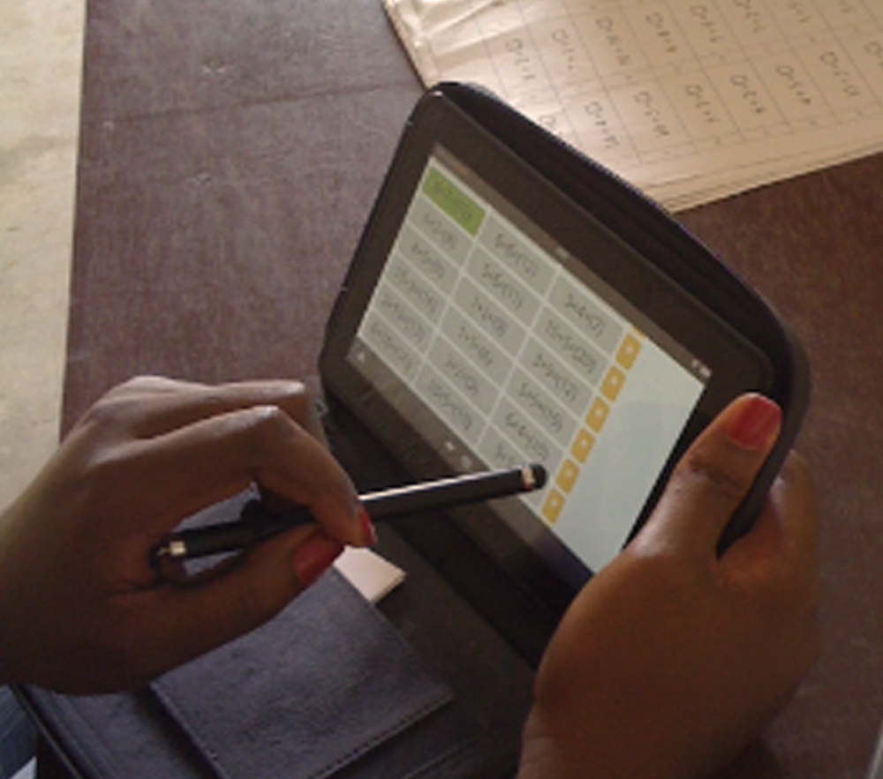
Research Design
Sample schools : 4 Treatment Schools
4 Control schools
1 Teacher per school
Total Grade 3 Learners Reached:
Baseline: 291/435
Endline: 284/435
Research Tools:
EGRA: Early Grade Reading Assessment
EGMA Early Grade Mathematics Assessment
In addition, the research team conducted:
Key Informant Interviews with grade 3 teachers in the treatment schools at endline.
Lesson observations: Math and English lessons

Slide 6
Findings

Slide 7
Preliminary Analysis: EGRA
Subtask | EGRA Pre |  |  |  | EGRA Post
 | Treatment |  | Control |  | Treatment |  | Control
 | Mean | Std. err. | Mean | Std. err. | Mean | Std. err. | Mean | Std. err.
Letter sounds | 24.3 | 1.16 | 22.6 | 1.84 | 28.1 | 1.15 | 20.3 | 1.48
Non-words | 14.5 | 0.70 | 11.5 | 1.07 | 14.7 | 0.76 | 9.2 | 0.91
Familiar words | 17.7 | 0.77 | 13.2 | 1.09 | 11.1 | 0.87 | 8.0 | 1.02
Oral reading story | 42.9 | 0.91 | 36.9 | 1.85 | 56.7 | 1.81 | 40.3 | 3.12
Reading comprehension | 1.6 | 0.16 | 0.4 | 0.10 | 1.2 | 0.14 | 0.4 | 0.10
Listening comprehension | 1.0 | 0.12 | 0.2 | 0.07 | 0.6 | 0.08 | 0.1 | 0.04

Slide 8
Preliminary Analysis: EGMA
Subtask | EGMA Pre |  |  |  | EGMA Post
 | Treatment |  | Comparison |  | Treatment |  | Comparison
 | Mean | Std. err. | Mean | Std. err. | Mean | Std. err. | Mean | Std. err.
Number identification | 18.1 | 0.26 | 13.3 | 0.65 | 18.4 | 0.25 | 13.9 | 0.73
Number discrimination | 9.7 | 0.08 | 9.2 | 0.14 | 9.7 | 0.06 | 9.0 | 0.15
Missing number | 6.2 | 0.20 | 5.0 | 0.29 | 5.9 | 0.20 | 5.3 | 0.27
Addition level 1 | 12.2 | 0.60 | 12.0 | 0.72 | 10.6 | 0.54 | 8.2 | 0.71
Addition level 2 | 4.0 | 0.13 | 3.5 | 0.24 | 4.0 | 0.15 | 3.1 | 0.24
Subtraction level 1 | 13.6 | 0.51 | 12.4 | 0.73 | 10.5 | 0.65 | 7.9 | 0.76
Subtraction level 2 | 3.9 | 0.14 | 3.9 | 0.20 | 4.1 | 0.16 | 3.5 | 0.23
Word problems | 3.4 | 0.16 | 2.5 | 0.22 | 3.3 | 0.12 | 3.0 | 0.21

Slide 9
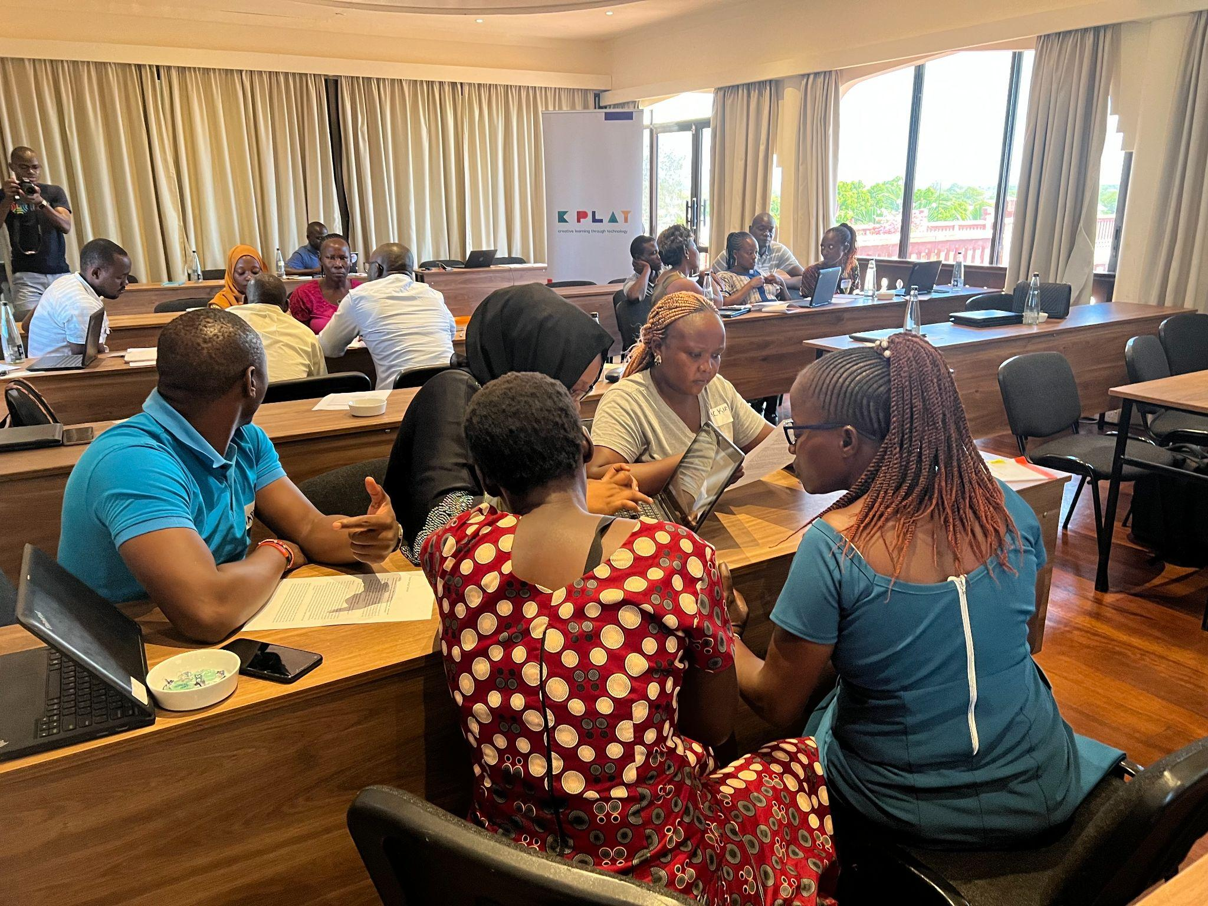
Did the pilot KPLAY FLN intervention lead to improved learning outcomes?
Preliminary assessment data, shows slight shifts in some literacy skills and no changes in numeracy however, qualitative data shows changes in:
Teachers greatly appreciated the focused training provided as part of this study:
a) Teachers found the focus on playful learning activities tailored to the specific literacy and numeracy skills incredibly helpful
b) The focus on relevant lesson plans helped teachers think about their own lesson planning strategies and how to integrate playful learning into their own planning
Teachers have demonstrated commendable efforts in integrating learner-centred and playful learning activities into their instructional approaches, however, there are still persistent challenges that impede these efforts

Slide 10
Did the pilot KPLAY FLN intervention lead to improved learning outcomes?
Preliminary assessment data, shows slight shifts in some literacy skills and no changes in numeracy however, qualitative data shows changes in:
Teachers greatly appreciated the focused training provided as part of this study:
a) Teachers found the focus on playful learning activities tailored to specific literacy and numeracy skills incredibly helpful
b) The focus on relevant lesson plans helped teachers think about their own lesson planning strategies and how to integrate playful learning into their own planning
Teachers have demonstrated commendable efforts in integrating learner-centred and playful learning activities into their instructional approaches, however, there are still persistent challenges that impede these efforts

Slide 11
Challenges that impede teacher’s efforts
A significant impediment identified was the challenge of comprehension among learners, attributed to their limited understanding of English, the designated language of instruction.
Effective Feedback strategies:While feedback strategies were shared during training, they may not be as effective in challenging conditions like large class sizes and limited resources.
Learners are not seen to be actively involved in the learning process: participation in learner centered lessons should employ strategies that are meaningful and effective for the learners

Slide 12
Thoughts and Reflections…
We are still analysing the findings, but would love to hear your thoughts and reflections about these initial findings.

